Slide 1
L2_Elementary Data Structures
Dr. Jay Dave
CSIS Dept, Hyderabad Campus

Slide 2
Data Structures and Algorithms Design (Merged-SEZG519/SSZG519)
L2_Elementary Data Structures

Slide 3
Content of L-2
Stacks
Stack ADT and Implementation
Applications
Queues
Queue ADT and Implementation
Applications
Linked List
Notion of positions in lists
List ADT and Implementation

Slide 4
Stacks

Slide 5
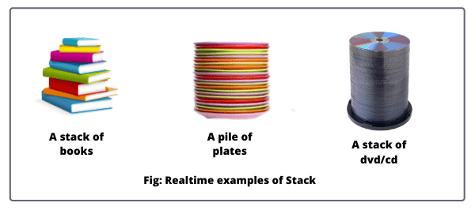
Stacks

Slide 6
Stack
A stack is a container of objects that are inserted and removed according to the last-in first-out (LIFO) principle.
List of operations on stack:
push(o): Insert object o at the top of the stack.
pop(): Remove from the stack and return the top object on the stack, that is, the most recently inserted element still in the stack; an error occurs if the stack is empty.
size(): Return the number of objects in the stack.
isEmpty(): Return, a Boolean indicating if the stack is empty.
top(): Return the top object on the stack, without removing it, an error occurs if the stack is empty.

Slide 7
Stack (push and pop)
Algorithm push(o):
if size( ) = N then
indicate that a stack-full error has occurred
t←t+1
S[t]←o
Algorithm pop( ):
if isEmpty( ) then
indicate that a stack-empty error has occurred
e←S[t]
S[t]← NULL
t←t-1
return e

Slide 8
Stack (size, isempty, and top)
Algorithm size( ):
return t+1
Algorithm isempty( ):
if t = 0 then
return TRUE
else
return FALSE
Algorithm top( ):
if t = 0 then
return NULL
else
return S[t]

Slide 9
Applications of Stack
(Expression Evaluation: Infix-Prefix-Postfix)
Arithmetic expression consists of operands and operators.
Notations for arithmetic expression:
Infix: <operand> <operator> <operand>
Prefix (Polish Notation): <operator> <operand> <operand>
Postfix (Reverse Polish Notation): <operand> <operand> <operator>
Infix notation can be converted to equivalent Prefix, Postfix notations.
Prefix and Postfix notations are parenthesis free and faster than infix.

Slide 10
Applications of Stack
(Expression Evaluation: Infix-Prefix-Postfix)
Infix:
((A+((B^C)-D))*(E-(A/C)))
Prefix (Polish Notation):
* + A - ^ BCD – E/AC
Postfix (Reverse Polish Notation):
ABC ^ D - + EAC / - *
 | In Stack | In Input
+ - | 2 | 1
* / | 4 | 3
^ | 5 | 6
operands | 8 | 7
( | 0 | 9
) | -- | 0

Slide 11
Applications of Stack
(Expression Evaluation: Infix-Prefix-Postfix)
Algorithm infixtopostfix(input):
input[input.LENGTH+1] ← ‘)’
PUSH(‘(‘)
while stack.isEmpty( ) = FALSE do
if input[i] is operand then
print input[i]
else if input[i] = ‘)’
while x← POP( ) ≠ ‘(’ do
print x
else if PR(input[i]) <= PR(TOP(s))
while PR(input[i]) <= PR(TOP(s)) do
x ← POP( )
print x
PUSH(input[i])
else
PUSH(input[i])
i←i+1

Slide 12
Applications of Stack
(Expression Evaluation: Infix-Prefix-Postfix)
Input | Stack | Output
(A+B)^C-(D*E)/F
(A+B)^C-(D*E)/F) | (
(A+B)^C-(D*E)/F) | ((
(A+B)^C-(D*E)/F) | (( | A
(A+B)^C-(D*E)/F) | ((+ | A
(A+B)^C-(D*E)/F) | ((+ | AB
(A+B)^C-(D*E)/F) | ( | AB+
(A+B)^C-(D*E)/F) | (^ | AB+
(A+B)^C-(D*E)/F) | (^ | AB+C
(A+B)^C-(D*E)/F) | ( - | AB+C^
(A+B)^C-(D*E)/F) | ( - ( | AB+C^
(A+B)^C-(D*E)/F) | ( - ( | AB+C^D

Slide 13
Applications of Stack
(Expression Evaluation: Infix-Prefix-Postfix)
Input | Stack | Output
(A+B)^C-(D*E)/F) | ( - ( * | AB+C^D
(A+B)^C-(D*E)/F) | ( - ( * | AB+C^DE
(A+B)^C-(D*E)/F) | ( - | AB+C^DE*
(A+B)^C-(D*E)/F) | ( - / | AB+C^DE*
(A+B)^C-(D*E)/F) | ( - / | AB+C^DE*F
(A+B)^C-(D*E)/F) | EMPTY | AB+C^DE*F/-

Slide 14
Applications of Stack
(Expression Evaluation: Infix-Prefix-Postfix)
Algorithm postfixeval(input):
input[input.LENGTH+1] ← ‘#’
i←1
while (item←input[i]) ≠ ‘#’ do
if item is operand then
push(item)
else
op←item
y←pop( )
x←pop( )
z←x op y
push(z)
i←i+1
answer←pop( )
return answer

Slide 15
Applications of Stack
(Expression Evaluation: Infix-Prefix-Postfix)
Input | Stack
AB+C^DE*F/-
23+5^67*3/-
23+5^67*3/- | 2
23+5^67*3/- | 23
23+5^67*3/- | 5
23+5^67*3/- | 5 5
23+5^67*3/- | 0
23+5^67*3/- | 0 6
23+5^67*3/- | 0 6 7
23+5^67*3/- | 0 42
23+5^67*3/- | 0 42 3
23+5^67*3/- | 0 14
23+5^67*3/- | -14
Infix: (A+B)^C-(D*E)/F
(A+B)^C-(D*E)/F
= (2+3)^5-(6*7)/3
= 5^5- (6*7)/3
= 5^5- 42/3 = 0 – 42/3
=0-14 = -14
Postfix: AB+C^DE*F/-

Slide 16
Applications of Stack
(Expression Evaluation: Infix-Prefix-Postfix)
Algorithm infixtoprefix(reverse(input)):
input[input.LENGTH+1] ← ‘(’
PUSH(‘)‘)
while stack.isEmpty( ) = FALSE do
if input[i] is operand then
output[j++] ← input[i]
else if input[i] = ‘(’
while x← POP( ) ≠ ‘)’ do
output[j++] ← x
else if PR(input[i]) <= PR(TOP(s))
while PR(input[i]) <= PR(TOP(s)) do
x ← POP( )
output[j++] ← x
PUSH(input[i])
else
PUSH(input[i])
i←i+1
print(reverse(output))

Slide 17
Applications of Stack
(Expression Evaluation: Infix-Prefix-Postfix)
Input | Stack | Output
(A+B)^C-(D*E)/F
F/)E*D(-C^)B+A(( | )
F/)E*D(-C^)B+A(( | ) | F
F/)E*D(-C^)B+A(( | )/ | F
F/)E*D(-C^)B+A(( | )/) | F
F/)E*D(-C^)B+A(( | )/) | FE
F/)E*D(-C^)B+A(( | )/)* | FE
F/)E*D(-C^)B+A(( | )/)* | FED
F/)E*D(-C^)B+A(( | )/ | FED*
F/)E*D(-C^)B+A(( | )- | FED*/
F/)E*D(-C^)B+A(( | )- | FED*/C
F/)E*D(-C^)B+A(( | )-^ | FED*/C

Slide 18
Applications of Stack
(Expression Evaluation: Infix-Prefix-Postfix)
Input | Stack | Output
F/)E*D(-C^)B+A(( | )-^ | FED*/C
F/)E*D(-C^)B+A(( | )-^) | FED*/C
F/)E*D(-C^)B+A(( | )-^) | FED*/CB
F/)E*D(-C^)B+A(( | )-^)+ | FED*/CB
F/)E*D(-C^)B+A(( | )-^)+ | FED*/CBA
F/)E*D(-C^)B+A(( | )-^ | FED*/CBA+
F/)E*D(-C^)B+A(( |  | FED*/CBA+^-
Reverse(FED*/CBA+^-) = -^+ABC/*DEF

Slide 19
Applications of Stack
(Expression Evaluation: Infix-Prefix-Postfix)
Algorithm prefixeval(reverse(input)):
input[input.LENGTH+1] ← ‘#’
i←1
while (item←input[1]) ≠ ‘#’ do
if item is operand then
push(item)
else
op←item
x←pop( )
y←pop( )
z←x op y
push(z)
i←i+1
answer←pop( )
return answer

Slide 20
Applications of Stack
(Expression Evaluation: Infix-Prefix-Postfix)
Input | Stack
FED*/CBA+^-
376*/532+^-
376*/532+^- | 3
376*/532+^- | 3 7
376*/532+^- | 3 7 6
376*/532+^- | 3 42
376*/532+^- | 14
376*/532+^- | 14 5
376*/532+^- | 14 5 3
376*/532+^- | 14 5 3 2
376*/532+^- | 14 5 5
376*/532+^- | 14 0
376*/532+^- | -14
Infix: (A+B)^C-(D*E)/F
(A+B)^C-(D*E)/F
= (2+3)^5-(6*7)/3
= 5^5- (6*7)/3
= 5^5- 42/3 = 0 – 42/3
=0-14 = -14
Prefix: -^+ABC/*DEF
Reverse(Prefix):
FED*/CBA+^-

Slide 21
Applications of Stack
(Expression Evaluation: Infix-Prefix-Postfix)
Algorithm postfixtoinfix(input):
input[input.LENGTH+1] ← ‘#’
i←1
while (item←input[1]) ≠ ‘#’ do
if item is operand then
push(item)
else
op←item
y←pop( )
x←pop( )
z←(x op y)
push(z)
i←i+1
answer←pop( )
return answer

Slide 22
Applications of Stack
(Expression Evaluation: Infix-Prefix-Postfix)
Input | Stack
AB+C^DE*F/- | A
AB+C^DE*F/- | AB
AB+C^DE*F/- | (A+B)
AB+C^DE*F/- | (A+B)C
AB+C^DE*F/- | ((A+B)^C)
AB+C^DE*F/- | ((A+B)^C)D
AB+C^DE*F/- | ((A+B)^C)DE
AB+C^DE*F/- | ((A+B)^C)(D*E)
AB+C^DE*F/- | ((A+B)^C)(D*E)F
AB+C^DE*F/- | ((A+B)^C)((D*E)/F)
AB+C^DE*F/- | (((A+B)^C)-((D*E)/F))
Postfix: AB+C^DE*F/-
Infix: ((A+B)^C)-((D*E)/F)

Slide 23
Applications of Stack
(Expression Evaluation: Infix-Prefix-Postfix)
Algorithm prefixtoinfix(reverse(input)):
input[input.LENGTH+1] ← ‘#’
i←1
while (item←input[1]) ≠ ‘#’ do
if item is operand then
push(item)
else
op←item
x←pop( )
y←pop( )
z←(x op y)
push(z)
i←i+1
answer←pop( )
return answer

Slide 24
Applications of Stack
(Expression Evaluation: Infix-Prefix-Postfix)
Input | Stack
FED*/CBA+^- | F
FED*/CBA+^- | F E
FED*/CBA+^- | F E D
FED*/CBA+^- | F (D*E)
FED*/CBA+^- | ((D*E)/F)
FED*/CBA+^- | ((D*E)/F) C
FED*/CBA+^- | ((D*E)/F) C B
FED*/CBA+^- | ((D*E)/F) C B A
FED*/CBA+^- | ((D*E)/F) C (A+B)
FED*/CBA+^- | ((D*E)/F) ((A+B)^C)
FED*/CBA+^- | (((A+B)^C)-((D*E)/F))
Prefix: -^+ABC/*DEF
Reverse(Prefix):
FED*/CBA+^-
Infix: ((A+B)^C)-((D*E)/F)

Slide 25
Applications of Stack
(Stack machines)
Stack-based machines and Register-based machines
Stack-based machines:
A = B * C – A
Postfix: A B C * A – =
 |  |  | C |  | A
 |  | B | B | B*C | D | D-A
 | A | A | A | A | A | A
Empty | Push A | Push B | Push C | MUL | Push A | SUB | POP
(1) | (2) | (3) | (4) | (5) | (6) | (7) | (8)

Slide 26
Applications of Stack
(Stack machines)
Stack-based machines and Register-based machines
Stack-based machines:
Advantages:
- Higher code density.
- Fewer registers required
Disadvantages:
- Slower access to variables

Slide 27
Applications of Stack
(Stack machines)
Stack-based machines and Register-based machines
Register-based machines:
A = B * C – A
mov r1, B
mul r1, C
sub r1, A
Advantages:
- Faster access to variables
- Fewer memory operations
Disadvantages:
- More registers for dense code

Slide 28
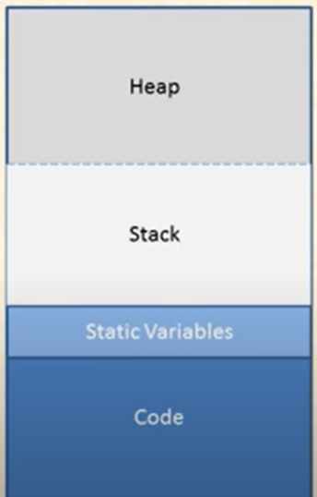
Applications of Stack
(Recursion)

Slide 29
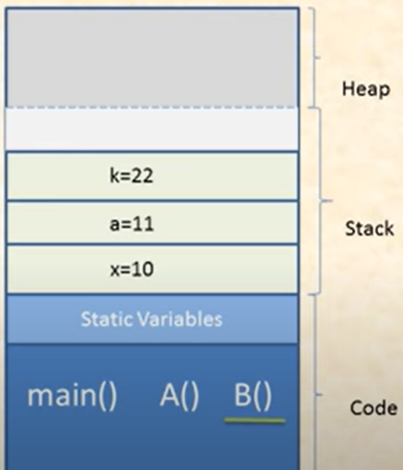
Applications of Stack
(Recursion)
void B(int k){
printf("%d",k);
}
void A(int a){
B(a*2);
printf("%d",a);
}
void main(){
int x;
A(x+1);
}

Slide 30
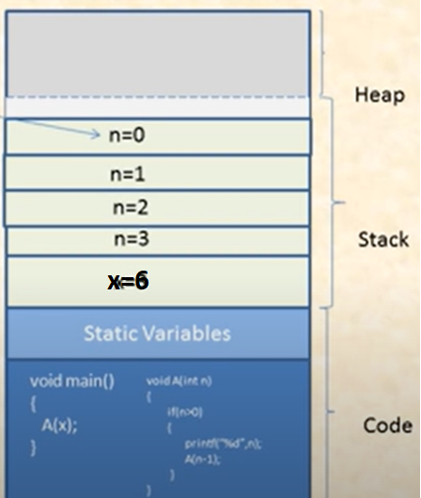
Applications of Stack
(Recursion)
void A(int n){
if(n>0){
printf("%d",n);
A(n-1);
}
}
void main(){
int x=6;
A(x/2);
}

Slide 31
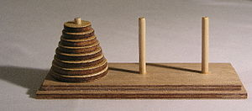
Applications of Stack
(Tower of Hanoi)

Slide 32
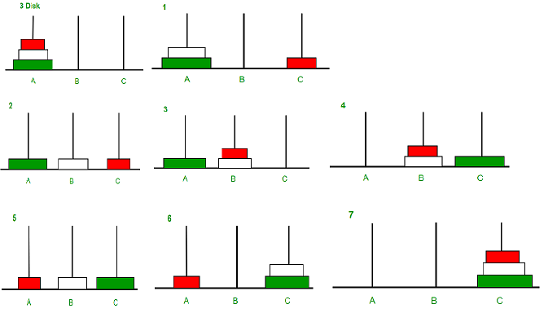
Applications of Stack
(Tower of Hanoi)

Slide 33
Applications of Stack
(Tower of Hanoi)
Move n-1 discs from A to B using C
Move a disc from A to C
Move n-1 discs from B to C using A
Total Moves = (2^{n}) - 1

Slide 34
Applications of Stack
(Tower of Hanoi)
#include<stdio.h>
void TOH(int n,int A,int B,int C){
if(n>0){
TOH(n-1,A,C,B);
printf("Move %dth disc from %d to %d\n",n,A,C);
TOH(n-1,B,A,C);
}
}
void main(){
int n=3;
int A=1,B=2,C=3;
TOH(n,A,B,C);
}

Slide 35
Applications of Stack
(Tower of Hanoi)

Slide 36
Applications of Stack
(Tower of Hanoi)
Iterative:
for i = 1 to (2^n)-1
if i%3 = 1 then
Move top disk from A to C
if i%3 = 2 then
Move top disk from A to B
if i%3 = 0 then
Move top disk from B to C

Slide 37
Queue

Slide 38
Queue
Close "cousin" of the stack
A queue is a container of objects that are inserted and removed according to the first-in first-out (FIFO) principle.
We usually say that elements enter the queue at the rear and are removed from the front.
List of Operations on Queue:
enqueue(o): Insert object o at the rear of the queue.
dequeue( ): Remove and return from the queue the object at the front; an error occurs if the queue is empty.
size( ): Return the number of objects in the queue.
isEmpty( ): Return a Boolean value indicating whether queue is empty.
front( ): Return, but do not remove, the front object in the queue, an error occurs if the queue is empty.

Slide 39
Queue (enqueue and dequeue)
Algorithm enqueue(o):
if size( ) = N then
indicate that a queue-full error has occurred
return
r←r+1
Q[r]←o
if f = 0 then
f = 1
Algorithm dequeue( ):
if isEmpty( ) then
indicate that a queue-empty error has occurred
return NULL
e←Q[f]
Q[f]← NULL
if f = r then
f ← 0
r ← 0
else
f←f+1
return e

Slide 40
Queue (size, isempty, front)
Algorithm size( ):
return r – f +1
Algorithm isempty( ):
if f = 0 then
return TRUE
else
return FALSE
Algorithm front( ):
if f = 0 then
return NULL
else
return Q[f]

Slide 41
Queue (Applications)
Task scheduling
Print spooling
Breadth-First Search (BFS)

Slide 42
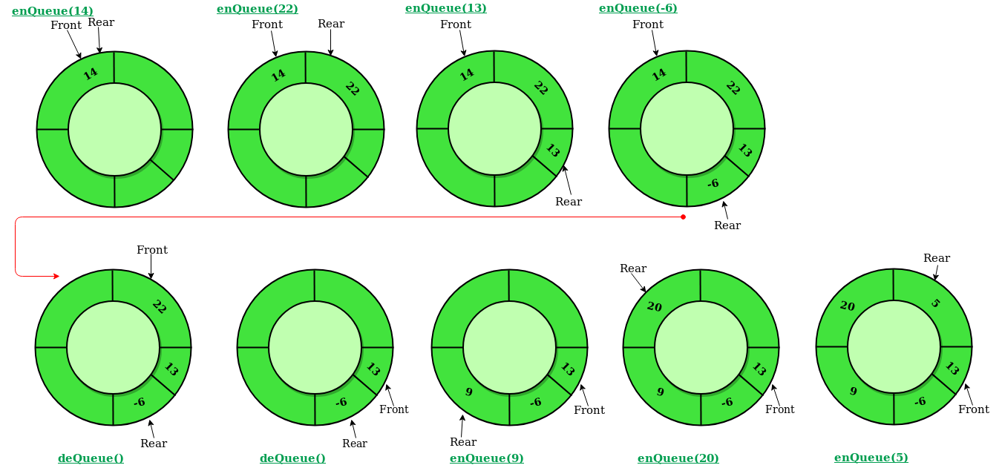
Circular Queue

Slide 43
Circular Queue (enqueue)
Algorithm enqueue(o):
if f = 0 then
f ← 1
r ← 1
else
if r mod n + 1 = f then
indicate that a queue-full error has occurred
return
else
r ← r mod n + 1
Q[r] ← o

Slide 44
Circular Queue (dequeue)
Algorithm dequeue(o):
if f = 0 then
indicate that a queue-empty error has occurred
return NULL
e ← Q[f]
Q[f] ← NULL
if f = r then
f ← 0
r ← 0
else
f ← f mod n +1
return e

Slide 45
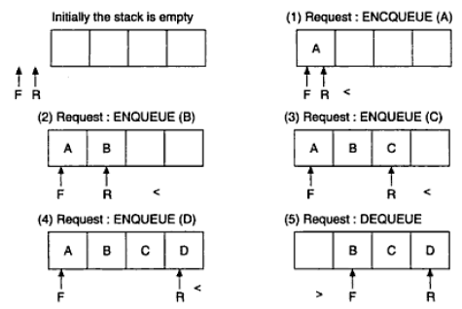
Circular Queue (example)

Slide 46
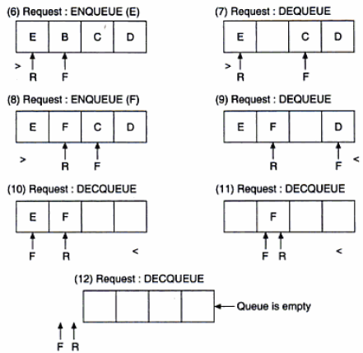
Circular Queue (example)

Slide 47
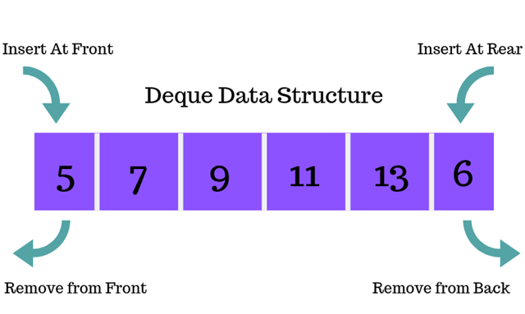
DQueue/Double Ended Queue

Slide 48
Dqueue (enqueue)
Algorithm enqueuerear(o):
if r mod n + 1 = f then
indicate that a queue-full error has occurred
return
else
if f = 0 and r = 0 then
f ← 1
r ← 1
else
r ← r mod n + 1
Q[r] ← o

Slide 49
Dqueue (enqueue)
Algorithm enqueuefront(o):
if r mod n + 1 = f then
indicate that a queue-full error has occurred
return
else
if f = 0 and r = 0 then
f ← 1
r ← 1
else if f = 1 then
f ← n
else
f ← f - 1
Q[f] ← o

Slide 50
Dqueue (dequeue)
Algorithm dequeuefront(o):
if f = 0 then
indicate that a queue-empty error has occurred
return NULL
e ← Q[f]
Q[f] ← NULL
if f = r then
f ← 0
r ← 0
else
f ← f mod n +1
return e

Slide 51
Dqueue (dequeue)
Algorithm dequeuerear(o):
if f = 0 then
indicate that a queue-empty error has occurred
return NULL
e ← Q[r]
Q[r] ← NULL
if f = r then
f ← 0
r ← 0
return e
else
if r = 1 then
r ← n
else
r ← r - 1
return e

Slide 52
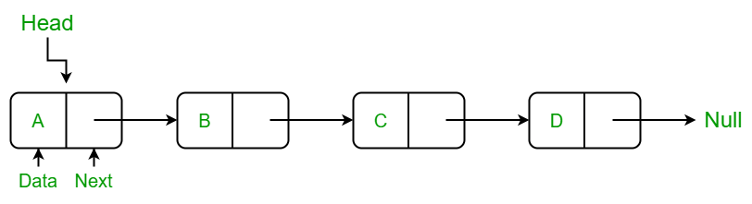
Linked List

Slide 53
Linked List
A collection of finite number of nodes where linear order is maintained by means of links or pointer to other node.
List of Operations on Linked List:
insertatfirst(o): Insert object o at the starting of the linked list.
insertatlast(o): Insert object o at the last of the linked list.
insertatany(o,key): Insert object o at the key position of the linked list.
deleteatfirst(): Delete object at the starting of the linked list.
deleteatlast(): Delete object at the last of the linked list.
deleteatany(key): Delete object at the key position of the linked list.
copy(link1,link2): Copy linked list 1 to linked list 2.
merge(link1,link2): Attach linked list2 behind linked list 1
search(key): search whether key is in linked list or not

Slide 54
Linked List
insertatfirst(header, Object o){
newnode ← Getnode( )
newnode.data ← o
newnode.next ← header
header ← new

Slide 55
Linked List
insertatlast(header, Object o){
newnode ← Getnode( )
newnode.data ← o
ptr ← header
while ptr.next ≠ NULL do
ptr ← ptr.next
ptr.next ← newnode
newnode.next←NULL

Slide 56
Linked List
insertatany(Object o, Object key): Insert object o after the key position of the linked list.
ptr ← header
if ptr = NULL then
Print “List Empty”
Exit
while ptr ≠ NULL do
if ptr.data = key then
newnode ← Getnode( )
newnode.data ← o
newnode.next ← ptr.next
ptr.next←newnode
Return
Print “Data not found”
Return

Slide 57
Linked List
deleteatfirst(): Delete object at the starting of the linked list.
ptr ← header
if ptr = NULL then
Print “List Empty”
Exit
retvalue ← ptr.data
header←ptr.next
Free(ptr)
return retval

Slide 58
Linked List
deleteatlast(): Delete object at the last of the linked list.
ptr ← header
if ptr = NULL then
Print “List Empty”
Exit
if ptr.next = NULL then
retval←ptr.data
Free(ptr)
Return retval
while (ptr.next).next ≠ NULL do
ptr ← ptr.next
ptr1 ← ptr.next
retval←ptr1.data
Free(ptr1)
ptr.next←NULL
Return retval

Slide 59
Linked List
deleteatany(Object key): Delete object at the key position of the linked list.
prev ← header
if prev = NULL then
Print “List Empty”
Exit
if prev.data = key then
retval ← prev.data
header ← prev.next
Free(prev)
Return retval
curr ← prev.next
while curr ≠ NULL do
if curr.data = key then
retval ← curr.data
prev.next ← curr.next
Free(curr)
Return retval
prev ← curr
curr ← curr.next
Print “Data not found”
Return NULL

Slide 60
Linked List
merge(header1,header2,header): Attach linked list2 behind linked list 1
ptr ← header1
while ptr.next ≠ NULL do
ptr ← ptr.next
ptr.next←header2
header←header1
return header

Slide 61
Linked List
search(Object key): search whether key is in linked list or not
ptr ← header
while ptr.next ≠ NULL do
if ptr.data = key then
return ptr
return NULL

Slide 62
Linked List (Applications)
Dynamic memory management
Polynomial calculations
Arithmetic on long numbers
Implementing graph, tree, queue, stack
Memory representation

Slide 63
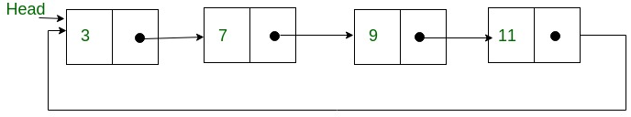
Circular Linked List

Slide 64
Circular Linked List
Advantages:
Efficient Accessibility
Example: Find the number of elements higher than or equal to each key in the list.
Input: 11 → 4 → 23 → 43 → 5
Output: 2,4,1,0,3
Solution to Null link problem
Null value in the link field may create some problem during the execution of the program if a proper care is not taken.
Disadvantages:
Infinite loop: Don’t know where to stop!!
Possible solution: Keep special header node, that has no data.

Slide 65
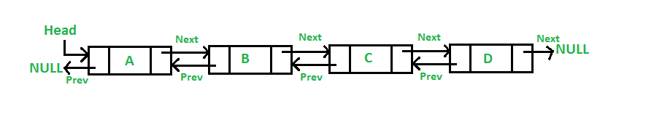
Doubly Linked List

Slide 66
Doubly Linked List
List of Operations on Linked List:
insertatfirst(o): Insert object o at the starting of the linked list.
insertatlast(o): Insert object o at the last of the linked list.
insertatany(o,key): Insert object o at the key position of the linked list.
deleteatfirst(): Delete object at the starting of the linked list.
deleteatlast(): Delete object at the last of the linked list.
deleteatany(key): Delete object at the key position of the linked list.
copy(link1,link2): Copy linked list 1 to linked list 2.
merge(link1,link2): Attach linked list2 behind linked list 1
search(key): search whether key is in linked list or not

Slide 67
Doubly Linked List
insertatfirst(header, Object o){
newnode ← Getnode( )
newnode.data ← o
newnode.next ← header
newnode.prev←NULL
header.prev←newnode
header ← newnode

Slide 68
Doubly Linked List
insertatlast(header, Object o){
newnode ← Getnode( )
newnode.data ← o
ptr ← header
while ptr.next ≠ NULL do
ptr ← ptr.next
ptr.next ← newnode
newnode.prev←ptr
newnode.next←NULL

Slide 69
Doubly Linked List
insertatany(Object o, Object key): Insert object o at the key position of the linked list.
newnode ← Getnode( )
newnode.data ← o
ptr ← header
while ptr.data ≠ key do
ptr ← ptr.next
newnode.next ← ptr.next
(ptr.next).prev←newnode
ptr.next←newnode
newnode.prev←ptr

Slide 70
Doubly Linked List
insertatany(Object o, Object key): Insert object o at the key position of the linked list.
ptr ← header
if ptr = NULL then
Print “List Empty”
Exit
while ptr ≠ NULL do
if ptr.data = key then
newnode ← Getnode( )
newnode.data ← o
newnode.next ← ptr.next
newnode.prev←ptr
ptr.next←newnode
ptr1←ptr.next
ptr1.prev←newnode
Return
Print “Data not found”
Return

Slide 71
Doubly Linked List
deleteatfirst(): Delete object at the starting of the linked list.
ptr ← header
if ptr = NULL then
Print “List Empty”
Exit
retvalue ← ptr.data
header←ptr.next
header.prev←NULL
Free(ptr)
return retval

Slide 72
Doubly Linked List
deleteatlast(): Delete object at the last of the linked list.
ptr ← header
if ptr = NULL then
Print “List Empty”
Exit
while ptr.next ≠ NULL do
ptr ← ptr.next
retval←ptr.data
(ptr.prev).next←NULL
Free(ptr)
return retval

Slide 73
Doubly Linked List
deleteatany(key): Delete object at the key position of the linked list.
ptr ← header
if ptr = NULL then
Print “List Empty”
Exit
while ptr.data ≠ Key do
ptr ← ptr.next
retval←ptr.data
(ptr.next).prev←ptr.prev
(ptr.prev).next←ptr.next
Free(ptr)
return retval

Slide 74
Doubly Linked List
deleteatany(key): Delete object at the key position of the linked list.
ptr ← header
if ptr = NULL then
Print “List Empty”
Exit
if ptr.data = key then
retval ← ptr.data
header ← ptr.next
Free(ptr)
Return retval
while ptr ≠ NULL do
if ptr.data = key then
retval ← ptr.data
ptr1 ← ptr.prev
ptr2 ← ptr.next
ptr1.next ← ptr2
ptr2.prev ← ptr1
Free(ptr)
Return retval
ptr ← ptr.next
Print “Data not found”
Return NULL

Slide 75
Doubly Linked List
merge(header1,header2,header): Attach linked list2 behind linked list 1
ptr ← header1
while ptr.next ≠ NULL do
ptr ← ptr.next
ptr.next←header2
header2.prev←ptr
header←header1
return header

Slide 76
Doubly Linked List
search(key): search whether key is in linked list or not
ptr ← header
while ptr.next ≠ NULL do
if ptr.data = key then
return ptr
return NULL

Slide 77
Homework Assignments
Implement Stack (i.e., Push and Pop, LIFO) using Queue data structure.
Implement Queue (i.e., Enqueue and Dequeue, FIFO) using Stack data structure.
We have discussed how to implement Stack using Array. Now, implement Stack using Linked-list.
We have discussed how to implement Queue using Array. Now, implement Queue using Linked-list.

Slide 78
References
Algorithms Design: Foundations, Analysis and Internet Examples Michael T. Goodrich, Roberto Tamassia, 2006, Wiley (Students Edition)
Data Structures, Algorithms and Applications in C++, Sartaj Sahni, Second Ed, 2005, Universities Press
Introduction to Algorithms, TH Cormen, CE Leiserson, RL Rivest, C Stein, Third Ed, 2009, PHI

Slide 79
Any Question!!

Slide 80
Thank you!!

